Slide 1

Database migrations don't have to be painful, but the road will be bumpy
Adrian Lungu
Software Engineer @ Adobe
Serban Teodorescu
Site Reliability Engineer @ Adobe

Slide 2
About us
Engineers in Adobe Audience Manger
  Data Management Platform
  Handles a lot of data
    200 TB of data
    150 BIL requests / day
  Over 30 Cassandra clusters with over 500 nodes
  Small operational overhead

Slide 3



Managing Large Scale Databases

Slide 4
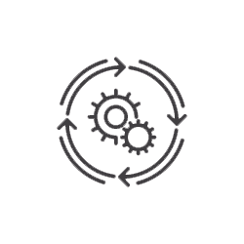
Managing Large Scale Databases
Automation

Slide 5

Managing Large Scale Databases
Automation
Innovation

Slide 6
Upgrading Large Scale Database
Agenda
The Why
The How
The Journey

Slide 7
Upgrading Large Scale Database
The Why
The How
The Journey

Slide 8

Upgrading Large Scale Database
The Why
Evolution
  Of the product
    Scale up
  Of the technology stack
    Hardware
    Software
    OS
    Drivers

Slide 9

Upgrading Large Scale Database
The Why
Evolution
  Of the product
    Scale up
  Of the technology stack
    Hardware
    Software
    OS
    Drivers

Slide 10
TEST IT!

Slide 11
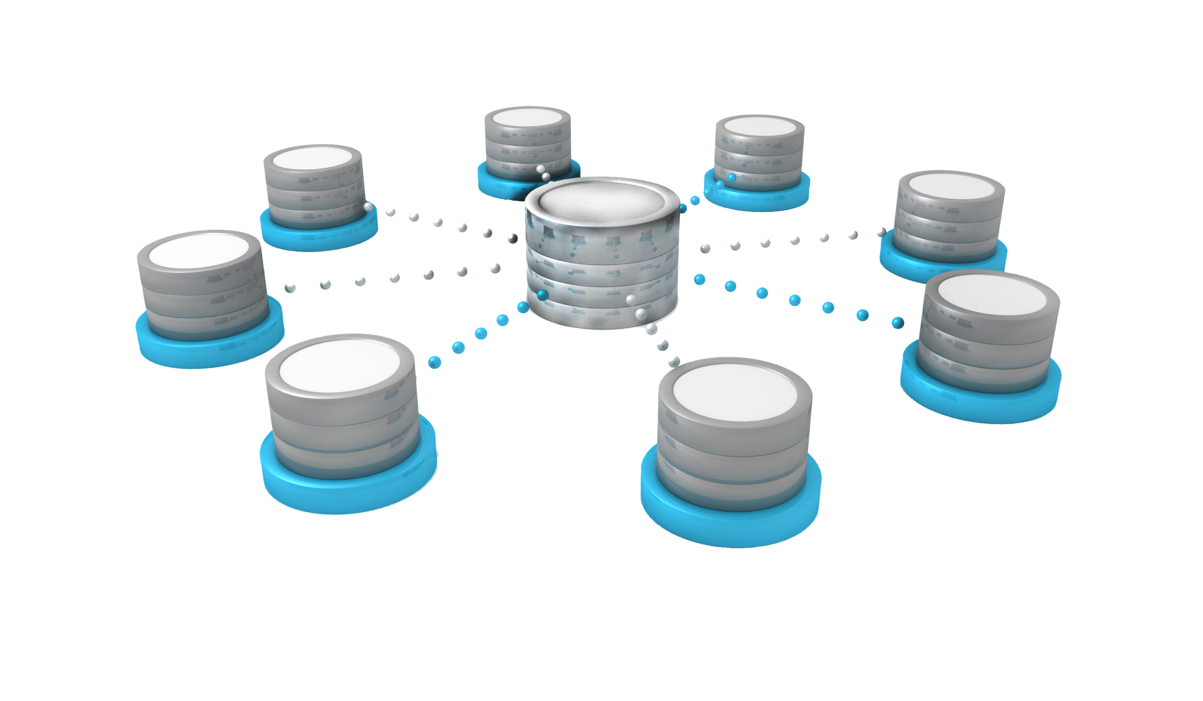




Test your database in Sandbox

Slide 12
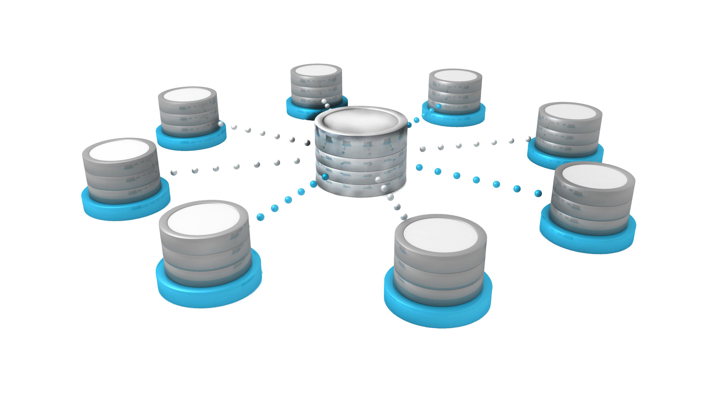
Test your database in Production

Slide 13
Upgrading Large Scale Database
The Why
The How
The Journey

Slide 14
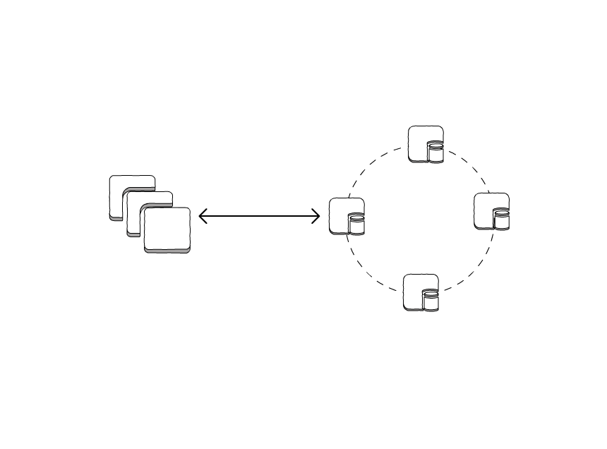
Testing in Production
The How
Read / Write
Application Server
Database cluster

Slide 15
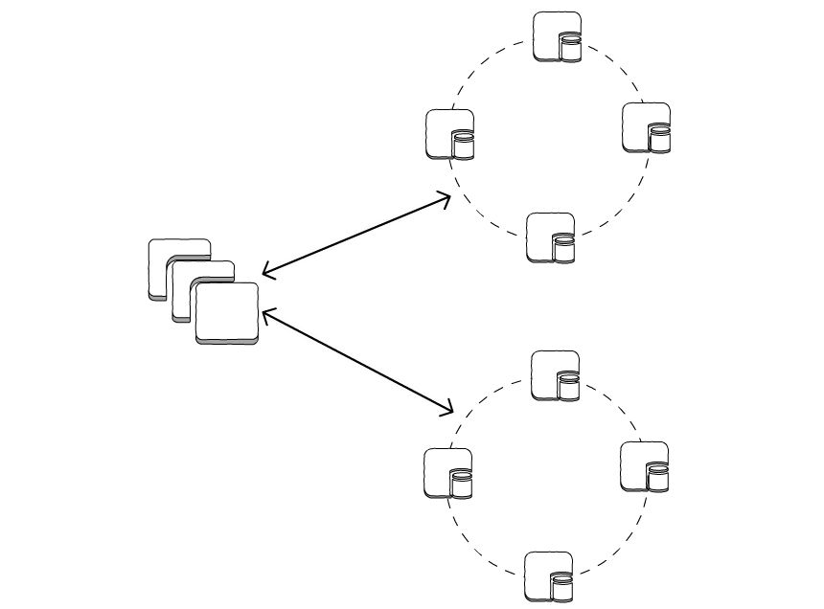

Testing in Production
The How
Current Database
Stable
Predictable
Read / Write
Application Server
Read / Write
Database candidate
Unpredictable performance
Inconsistent results

Slide 16
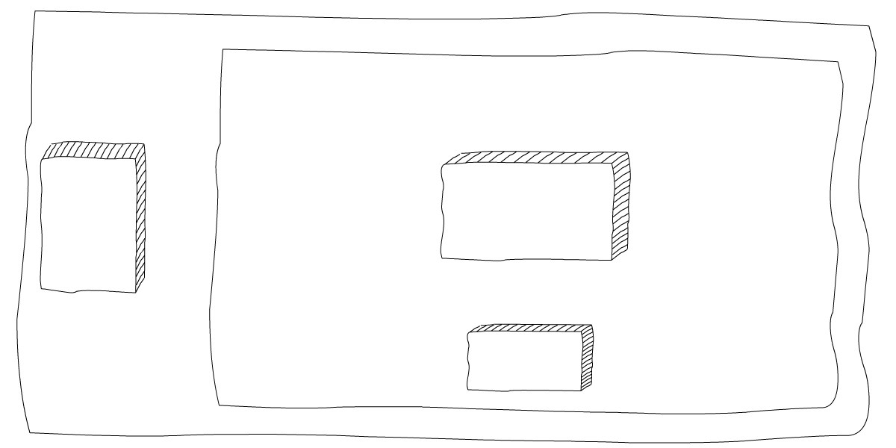
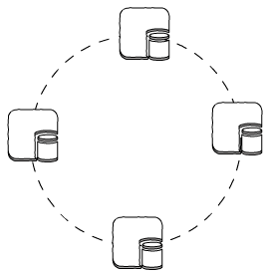
Testing in Production
The How
Application Server
CQL Client
Business
Logic
Strategy Executor
Main block unit
Executes queries
Composable
Request
Database
Response
Metrics
registry

Slide 17
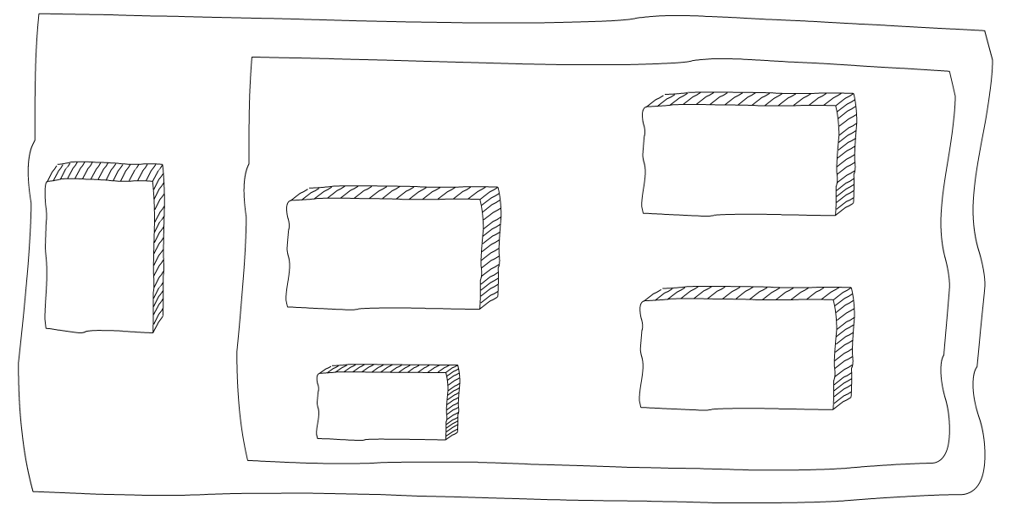
Testing in Production
The How
Application Server
CQL Client
ACTIVE
Strategy Executor
Business
Logic
MIGRATION
Strategy Executor
PASSIVE
Strategy Executor
Request
Metrics
registry

Slide 18
Testing in Production
The How
Application Server
CQL Client
ACTIVE
Strategy Executor
Business
Logic
MIGRATION
Strategy Executor
PASSIVE
Strategy Executor
Request
Response from
the old cluster
Metrics
registry

Slide 19
Testing in Production
The How
Application Server
CQL Client
ACTIVE
Strategy Executor
Business
Logic
MIGRATION
Strategy Executor
PASSIVE
Strategy Executor
Request
Response from
the old cluster
Metrics
registry
Response from
the new cluster

Slide 20
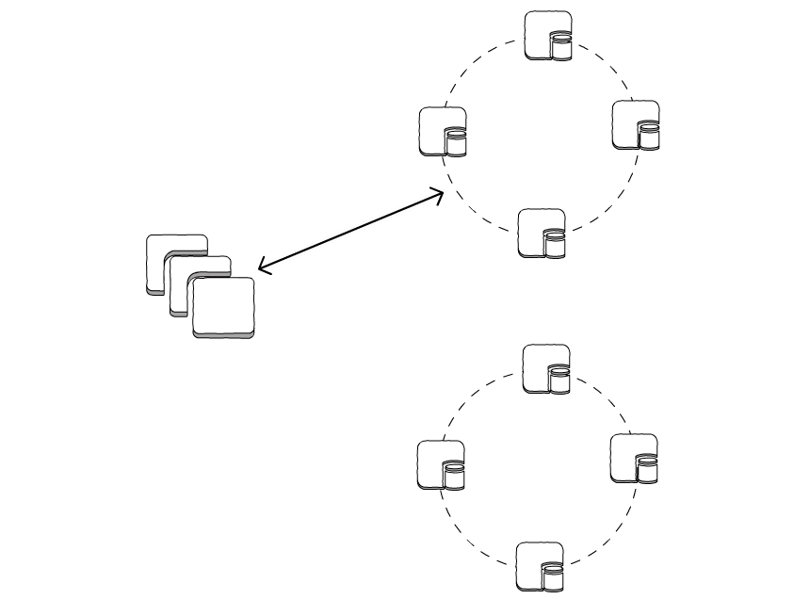
Migration Steps
    1. Start the new cluster
active connection
Old Database
New Database

Slide 21
Migration Steps
    1. Start the new cluster
    2. Start writing in both clusters.
        Old cluster is primary
        New cluster only used to gather metrics
active connection
Old Database
passive connection
New Database

Slide 22
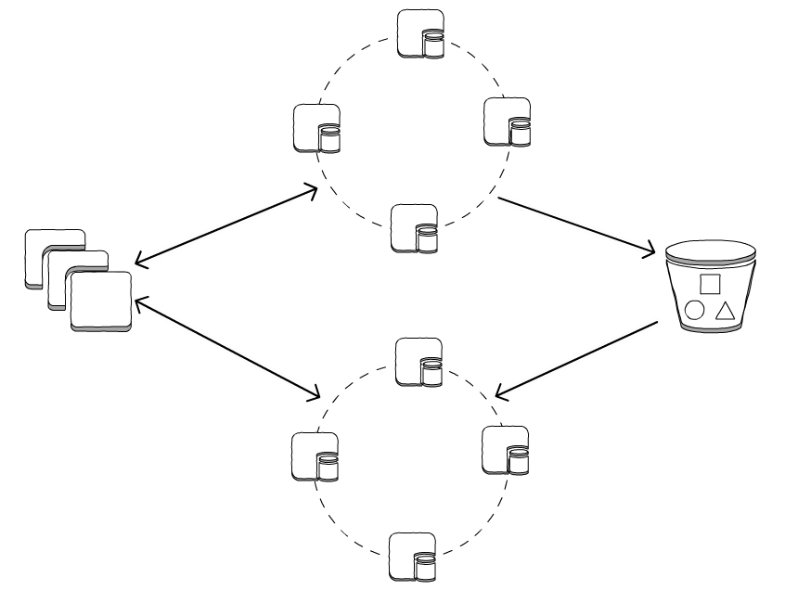
Migration Steps
    1. Start the new cluster
    2. Start writing in both clusters.
        Old cluster is primary
        New cluster only used to gather metrics
active connection
    3. Take a snapshot of the old cluster
    4. Restore saved backup in the new cluster
backup
Old Database
passive connection
restore
New Database

Slide 23
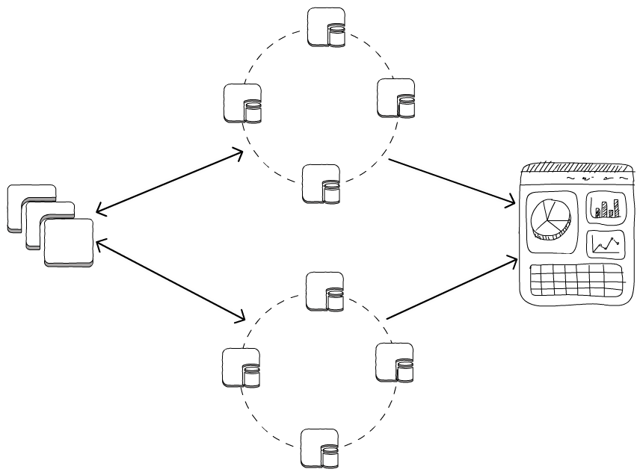
Migration Steps
    1. Start the new cluster
    2. Start writing in both clusters.
        Old cluster is primary
        New cluster only used to gather metrics
active connection
    3. Take a snapshot of the old cluster
    4. Restore saved backup in the new cluster
metrics
Old Database
    5. Analyze the new cluster
        Data
        Performance
passive connection
metrics
New Database

Slide 24
Migration Steps
    1. Start the new cluster
    2. Start writing in both clusters.
        Old cluster is primary
        New cluster only used to gather metrics
passive connection
    3. Take a snapshot of the old cluster
    4. Restore saved backup in the new cluster
Old Database
    5. Analyze the new cluster
        Data
        Performance
active connection
    6. Switch clusters roles
        New cluster is primary
        Old cluster used for rollback
New Database
    7. Decommission old Cassandra cluster

Slide 25
What do we upgrade?
Linear Scaling

Slide 26
What do we upgrade?
Linear Scaling
Virtual Nodes
(Greedy token allocation)

Slide 27
What do we upgrade?
Linear Scaling
Virtual Nodes
(Greedy token allocation)
Cassandra Upgrade
(2.1 -> 3.0)

Slide 28
What do we upgrade?
Linear Scaling
Virtual Nodes
(Greedy token allocation)
Data sharding
Cassandra Upgrade
(2.1 -> 3.0)

Slide 29
What do we upgrade?
Linear Scaling
Update AWS hardware
Virtual Nodes
(Greedy token allocation)
Data sharding
Cassandra Upgrade
(2.1 -> 3.0)

Slide 30
What do we upgrade?
Linear Scaling
Update AWS hardware
Virtual Nodes
(Greedy token allocation)
Upgrade Operating System
Data sharding
Cassandra Upgrade
(2.1 -> 3.0)

Slide 31
What do we upgrade?
Linear Scaling
Update AWS hardware
Virtual Nodes
(Greedy token allocation)
Upgrade Operating System
Data sharding
Cassandra Upgrade
(2.1 -> 3.0)
Drivers
JVM

Slide 32
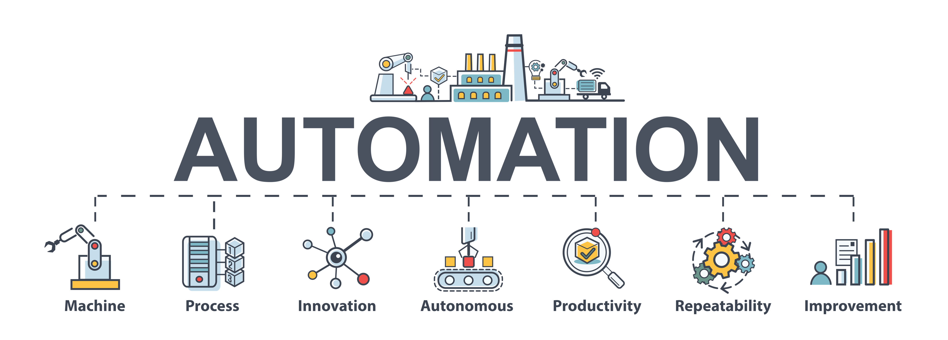
Automation

Slide 33
Automation
"If we are engineering processes and solutions that are not automatable, we continue having to staff humans to maintain the system. If we have to staff humans to do the work, we are feeding the machines with the blood, sweat, and tears of human beings. Think The Matrix with less special effects and more pissed off System Administrators.”
”Site Reliability Engineering” book, Chapter 7 ” The Evolution of Automation at Google”
https://landing.google.com/sre/sre-book/chapters/automation-at-google/

Slide 34
Automation
How?
What we already had:
  Terraform for cloud provisioning
https://github.com/adobe/ops-cli
“Infrastructure as code”
Consistent across deployments
Slow, but reliable

Slide 35
Automation
How?
What we already had:
  Terraform for cloud provisioning
  Puppet for configuration management
Hierarchical configurations and code
Consistency across deployments
Slow bootstrap
Reliability issues (90% success rate is not enough)

Slide 36
Automation
How?
What we already had:
  Terraform for cloud provisioning
  Puppet for configuration management
  Based on Amazon Linux 2014
Old, but reliable
Lightweight image - Puppet has to install everything, every time

Slide 37
Automation
How?
What we already had:
  Terraform for cloud provisioning
  Puppet for configuration management
  Based on Amazon Linux 2014
What we didn’t have:
  pre-backed AMI
Faster bootstrap
Fewer dependencies:
  packages
  puppet master server
  AWS API calls

Slide 38
Automation
How?
What we already had:
  Terraform for cloud provisioning
  Puppet for configuration management
  Based on Amazon Linux 2014
What we didn’t have:
  pre-backed AMI
  Cassandra 3 support in puppet

Slide 39
Automation
How?
What we already had:
  Terraform for cloud provisioning
  Puppet for configuration management
  Based on Amazon Linux 2014
What we didn’t have:
  pre-backed AMI
  Cassandra 3 support in puppet
  Fully automated Cassandra ring bootstrap
Steps:
  Manually join seed nodes
  Manually create tables
  Start ansible playbook to join the other nodes

Slide 40
Automation
How?
What we already had:
  Terraform for cloud provisioning
  Puppet for configuration management
  Based on Amazon Linux 2014
What we didn’t have:
  pre-backed AMI
  Cassandra 3 support in puppet
  Fully automated Cassandra ring bootstrap
Lesson #1
Automation is great! Let’s have more of it!
(but be ready for manual work)

Slide 41
Upgrading Large Scale Database
The Why
The How
The Journey

Slide 42
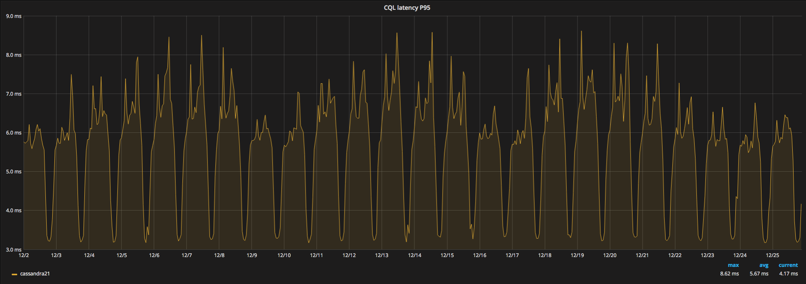
First Tryout - Small Cassandra Cluster
The Old Cluster

Slide 43
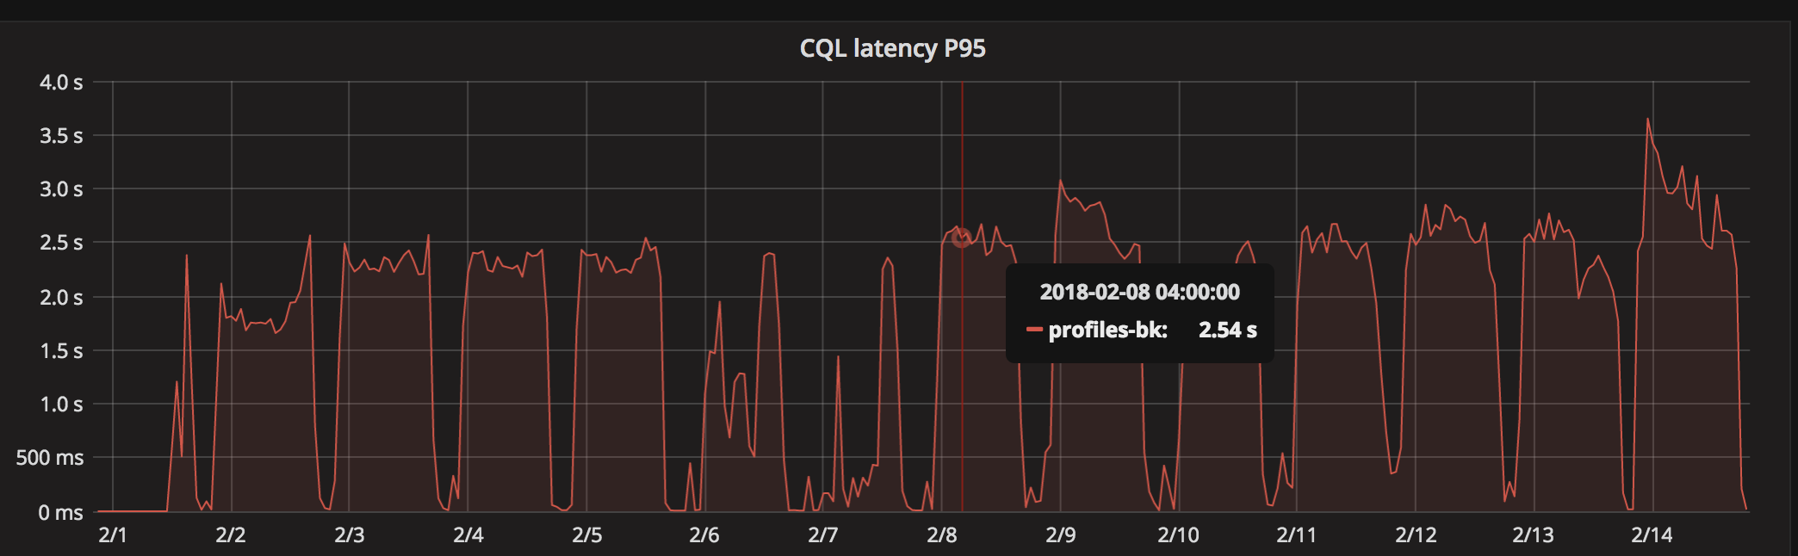
First Tryout - Small Cassandra Cluster
The New Cluster

Slide 44
First Tryout - Small Cassandra Cluster
Lesson #2: Do ONLY ONE CHANGE at a time

Slide 45
First Tryout - Small Cassandra Cluster
Lesson #3 Start SMALL

Slide 46
AWS i3 + CentOS != Love
New hardware (i3, NVMe SSD) might not work perfectly on all operating systems
AWS supports only Amazon Linux
Some kernel settings can improve NVMe performance in CentOS
  nvme.io_timeout
Our choice - Amazon Linux 2017.09

Slide 47
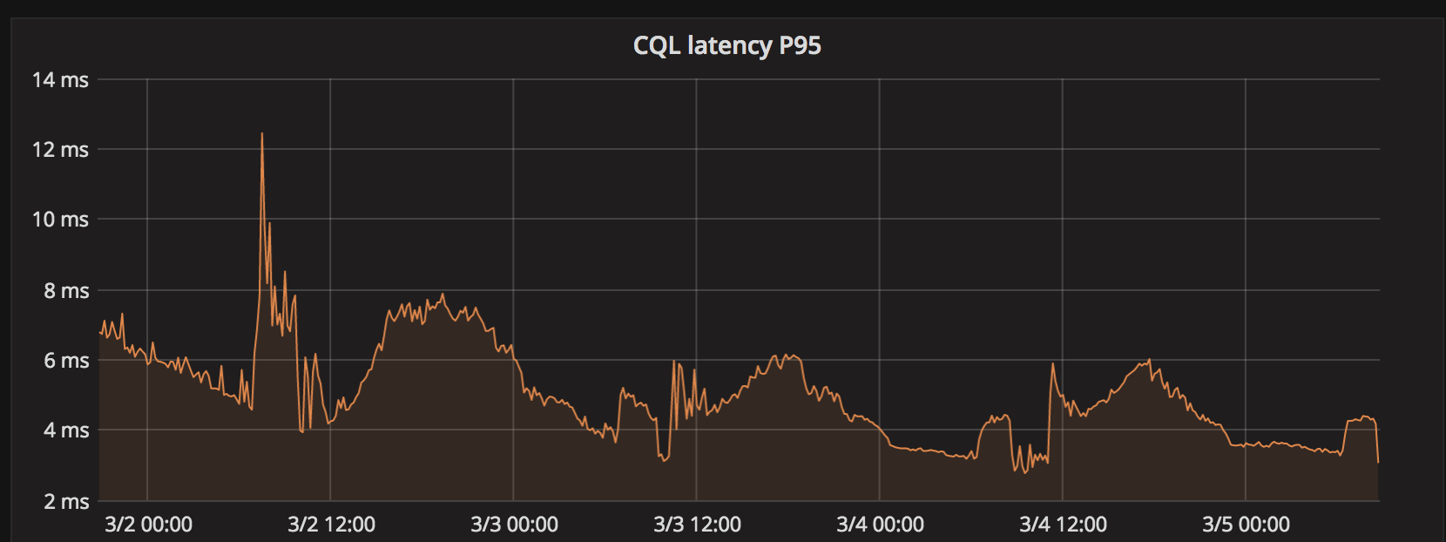
Final tryout – Large Cassandra Cluster

Slide 48
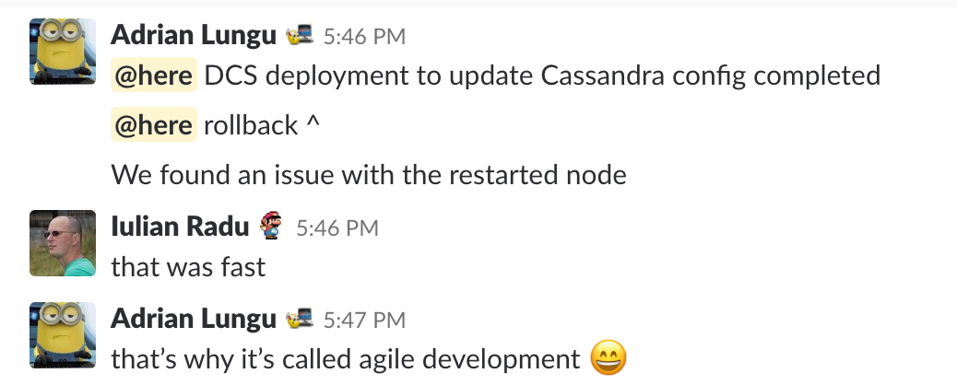
Final(?) tryout – Large Cassandra Cluster

Slide 49
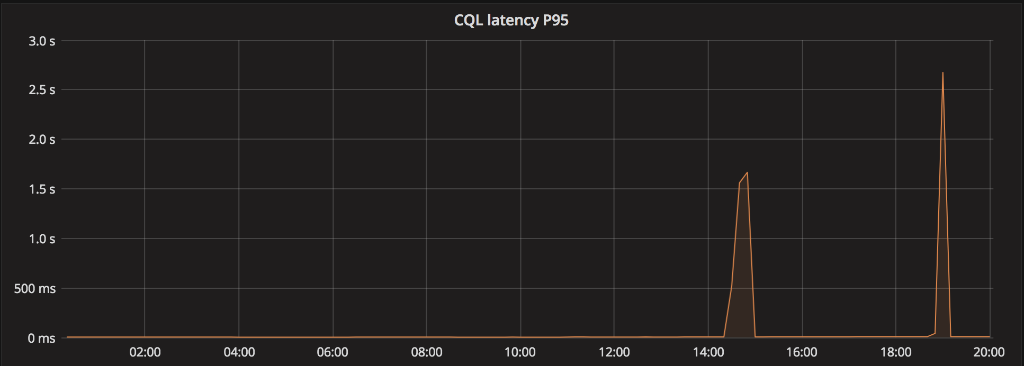
Final(?) tryout – Large Cassandra Cluster

Slide 50
Final(?) tryout – Large Cassandra Cluster
Lesson #4: SMALL SCALE success is NEVER ENOUGH

Slide 51
Zing & Falcon (JIT)
Zing JVM, made by Azul
  Kernel module, reserves a predetermined amount of memory
  Linux doesn’t handle that memory, it’s up to the Zing service
“Pauseless Garbage Collection”
  larger heap
  Less GC pausing
Zing Falcon
  Updated JIT compiler added in newer versions

Slide 52
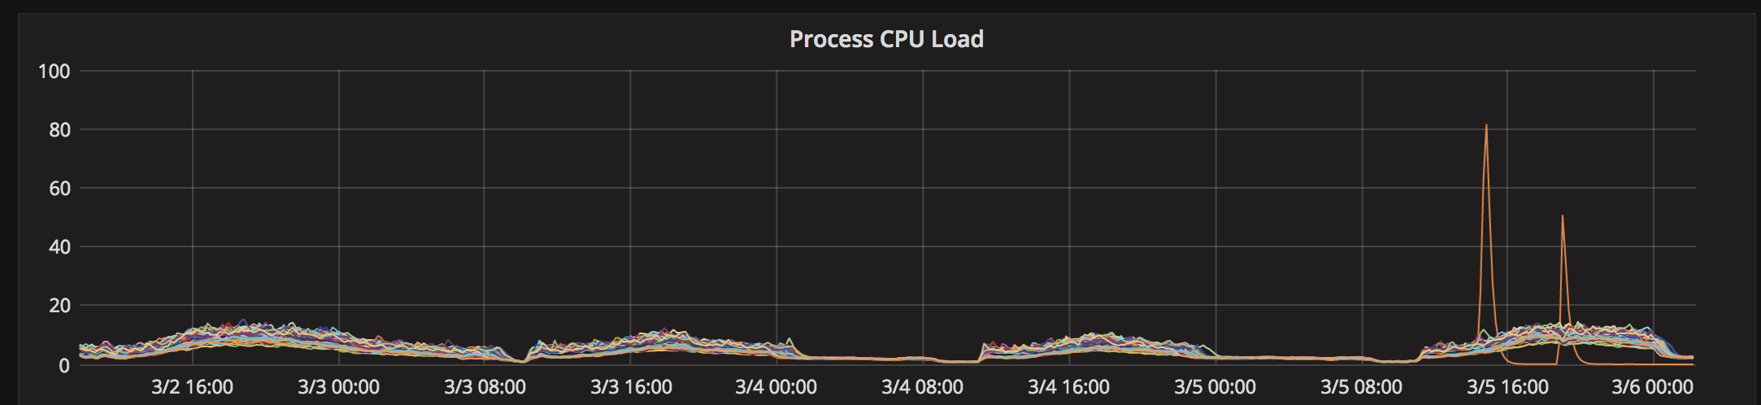
Zing & Falcon (JIT)

Slide 53
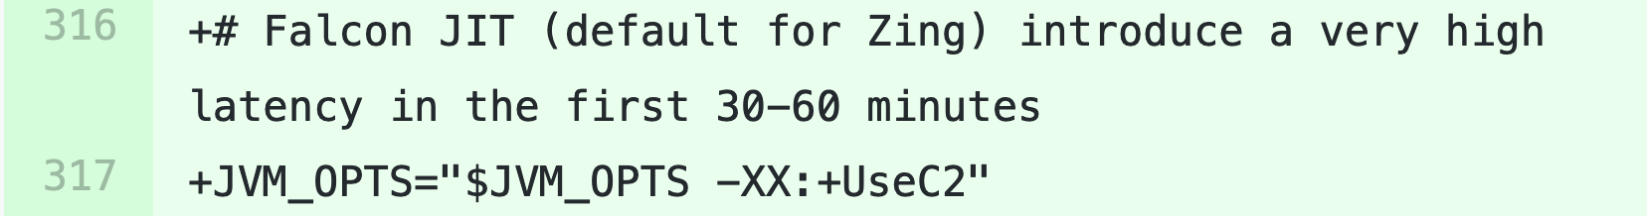
Zing & Falcon (JIT)
Solution

Slide 54
Why? One slow node impact
Slow node => slow data streaming
No master to determine slow nodes
Data must be replicated to predetermined node(s)

Slide 55
One slow node impact
A
B
C
D
E
F
G
H
No VNodes

Slide 56
One slow node impact
A
B
C
D
E
F
G
H
A
B
C
D
E
F
G
H
B1B1 B2
B4
No VNodes
4 VNodes

Slide 57
One slow node impact
Our setup
Replication Factor = 2
8 VNodes / instance
EC2Snitch
  replica is always in another AWS availability zone (datacenter)
3 availability zones x 12 instances = 36 instances
One node impact
  Maximum 66% of availability zone, on average 50%
  8 VNodes distributed to 12 instances

Slide 58
One slow node impact
Lesson #5: A slow node is worse than a dead one

Slide 59

Let’s pop the champagne!

Slide 60
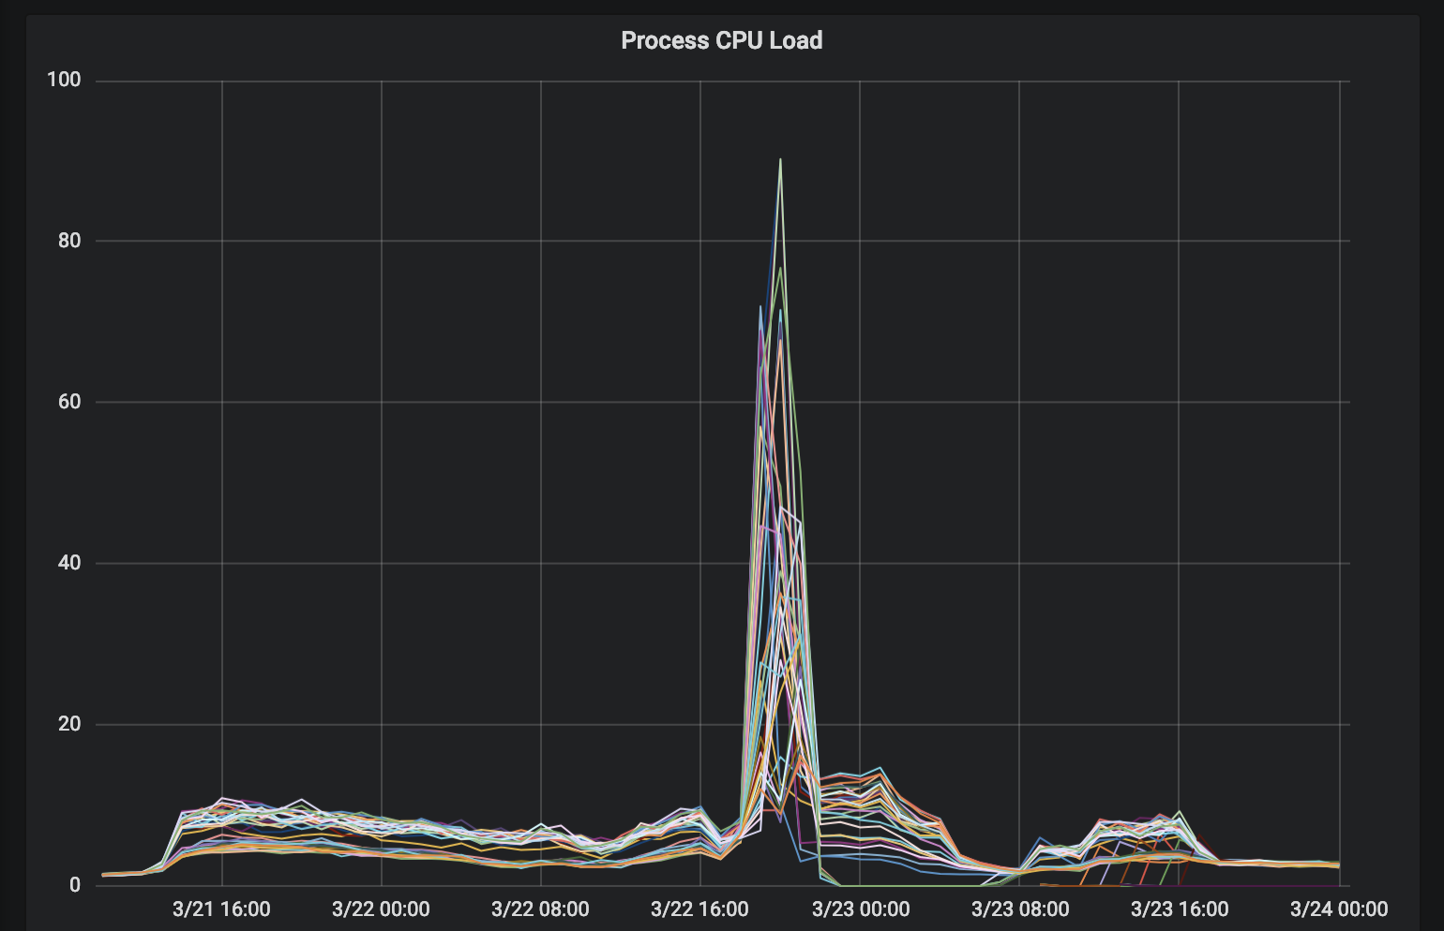
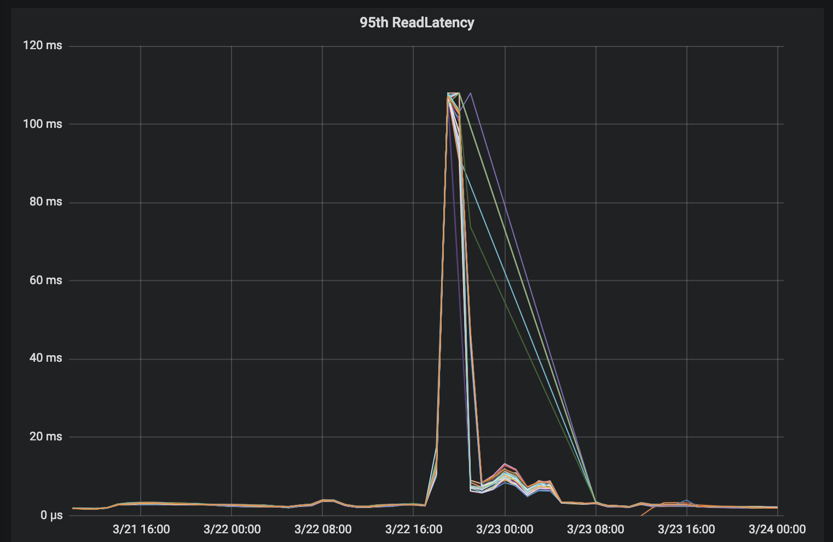
Might be too early?

Slide 61
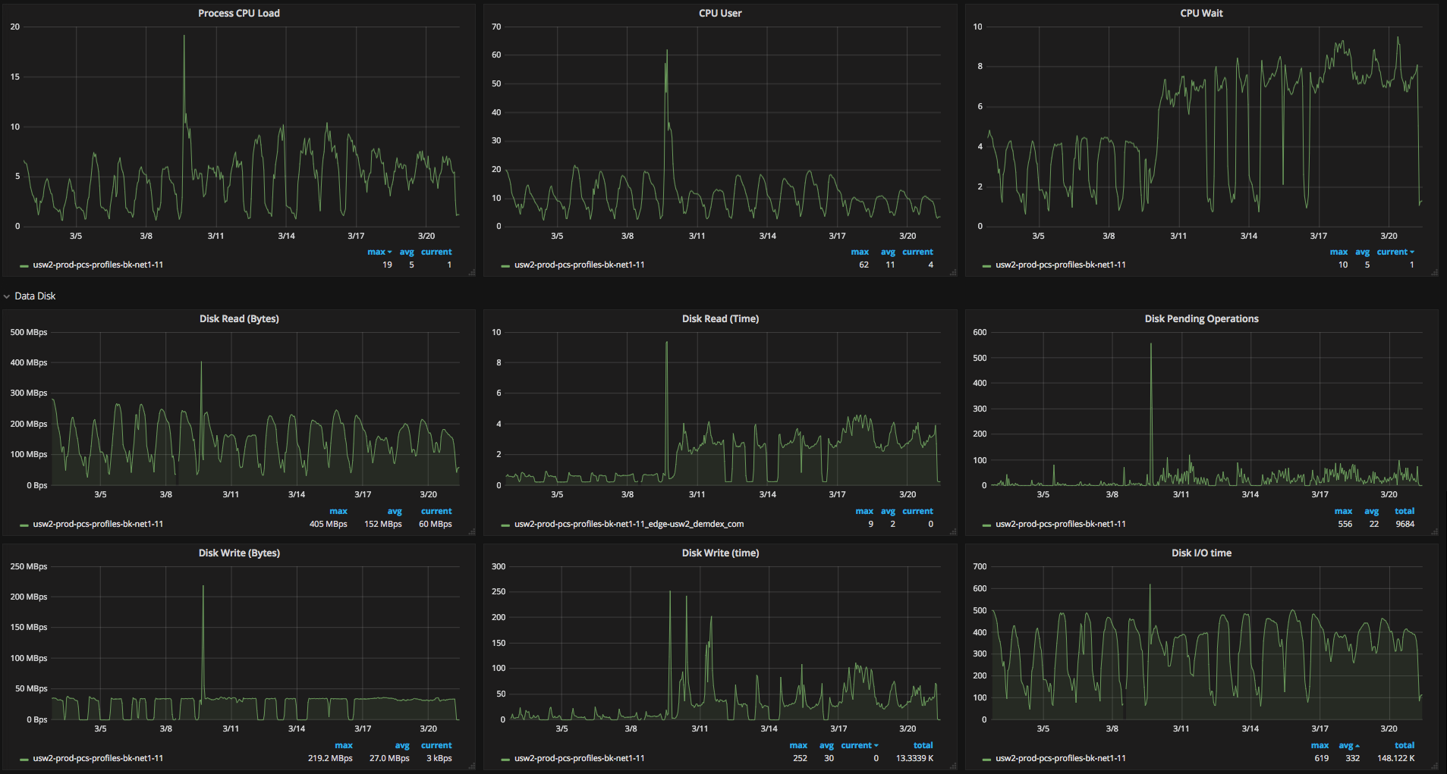
Investigation
Disk performance metrics

Slide 62
Investigation
Disk performance metrics

Slide 63
Investigation
Disk performance metrics

Slide 64
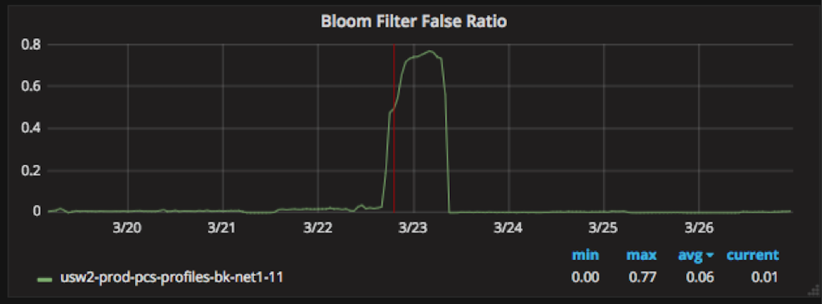
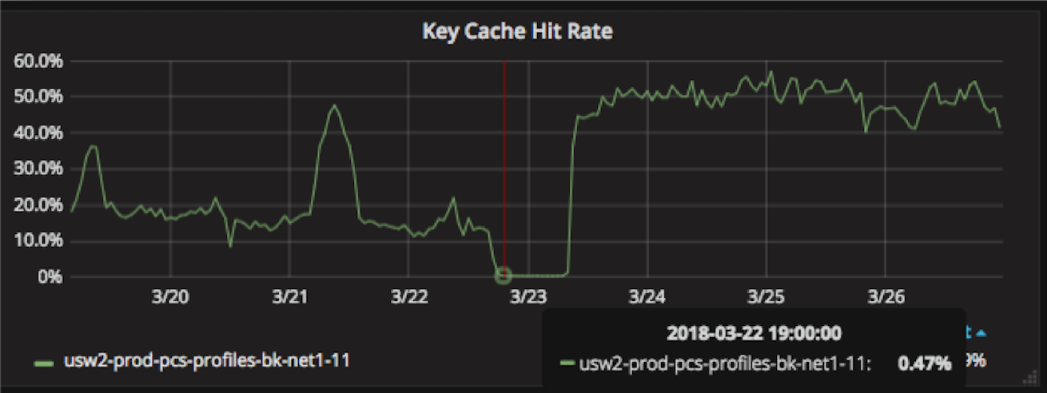
Bloom filters impact

Slide 65
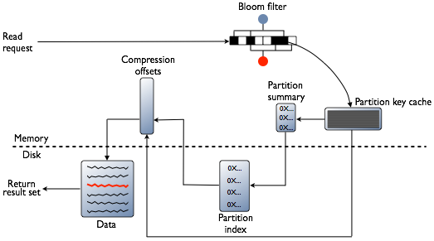
Bloom filters
Probabilistic data structure giving one of two possible states for the data:
Does not exist in the given file
Probably exists in the given file.

Slide 66

Bloom filters
Probabilistic data structure giving one of two possible states for the data:
Does not exist in the given file
Probably exists in the given file.

Slide 67
Bloom filters
Solution
http://cassandra.apache.org/doc/4.0/operating/bloom_filters.html

Slide 68
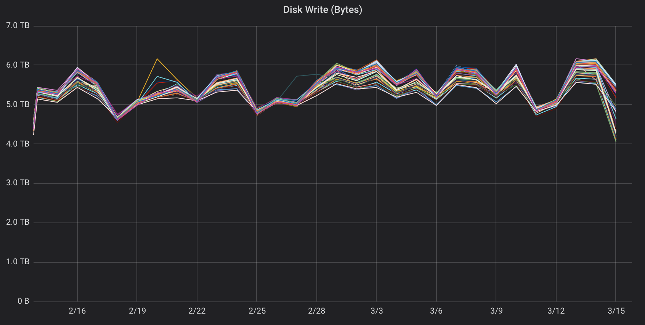
Investigation
Disk usage

Slide 69
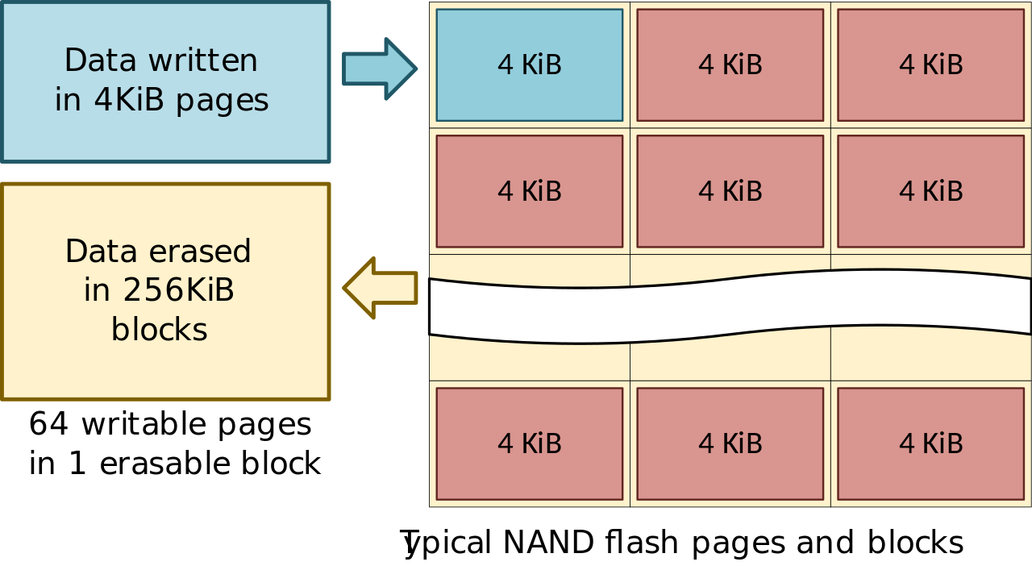
NVMe & SSDs
NVMe increased parallelism
Write amplification
High writes
  Disks rewritten several times a day
Thanks to Dmitry Nosachev for his image of a SSD pages and blocks, licensed under a Creative Commons Attribution license.

Slide 70
NVMe SSDs

Slide 71
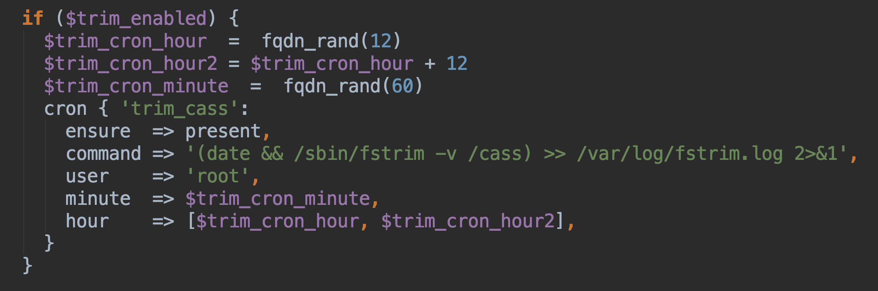
NVMe & SSDs
Solution

Slide 72
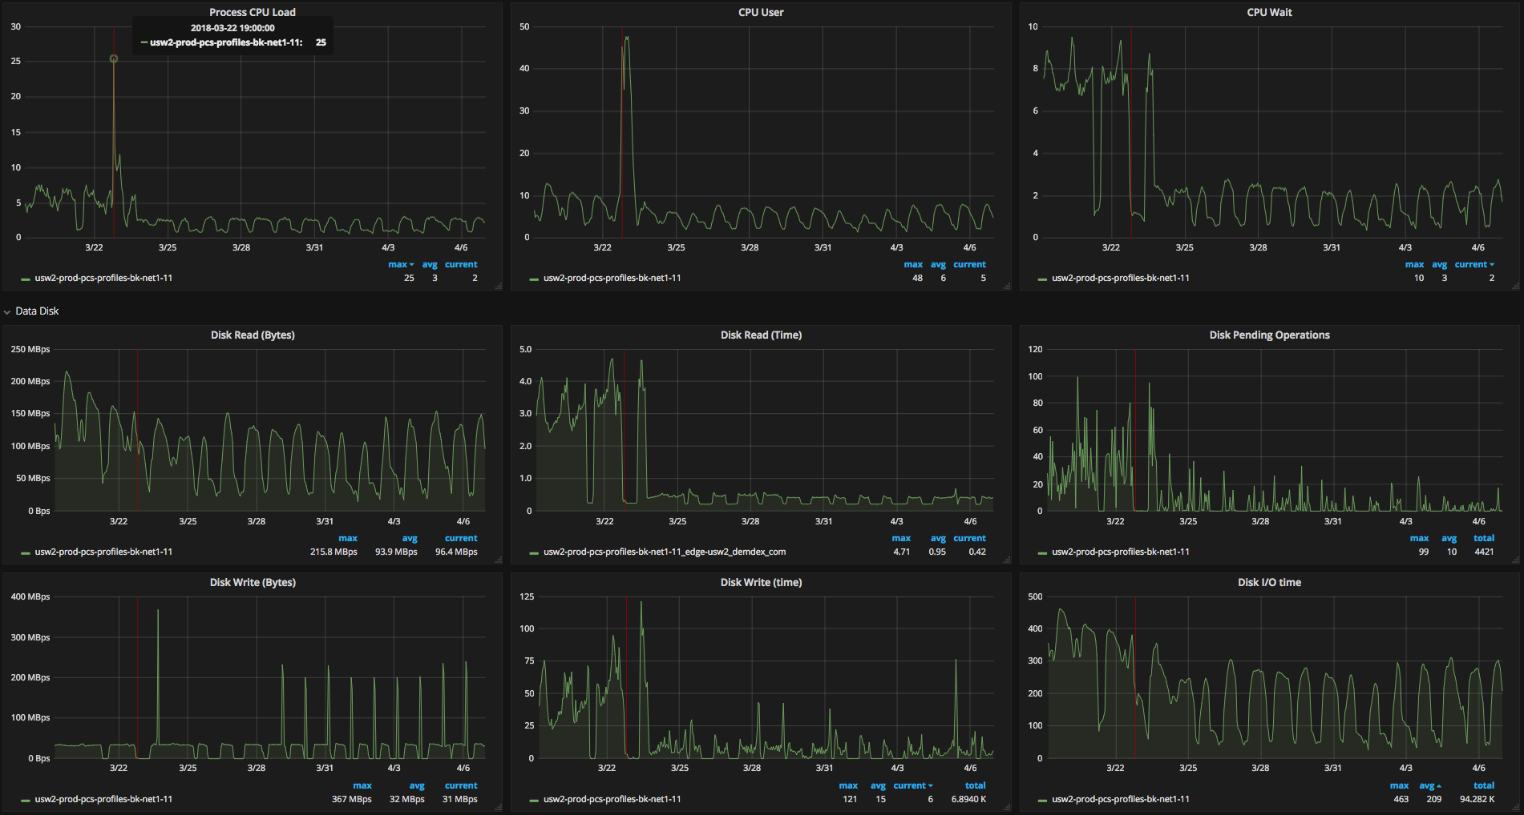
NVMe SSDs & TRIM
Outcome

Slide 73
NVMe SSDs & TRIM
Outcome
Lesson #6: Beware of the new technology unknown

Slide 74
NVMe SSDs & TRIM
Outcome
Lesson #7: ALWAYS READ THE MANUAL

Slide 75
Lessons learned (recap)
Automate
Start small
Do only one change at a time
Small scale success is never enough
A slow node is far worse than a dead one
Beware of the new technology unknown
Always read the manual

Slide 76
Achievements
Technology stack upgrade
  Hardware
  Operating System
  Drivers
  Cassandra (2.1 -> 3.0)
Virtual Nodes in large clusters
  Linear scaling
  Automate scaling
    Ansible and Ansible Tower

Slide 77
Thank you!

Slide 78
Resources
https://www.datastax.com/dev/blog/token-allocation-algorithm
https://aws.amazon.com/blogs/aws/now-available-i3-instances-for-demanding-io-intensive-applications/
https://support.azul.com/hc/en-us/articles/115000605283-Cassandra-on-Zing
https://docs.azul.com/zing/UnderstandMemUse_UnderstandMemAllocation.htm
https://www.azul.com/products/zing/pgc/
http://cassandra.apache.org/doc/4.0/operating/bloom_filters.html
https://en.wikipedia.org/wiki/Write_amplification
https://docs.aws.amazon.com/AWSEC2/latest/UserGuide/nvme-ebs-volumes.html#timeout-nvme-ebs-volumes
https://www.anandtech.com/show/2738/8

Slide 79


Rate today ’s session
Session page on conference website
O’Reilly Events App

Slide 80
Q & A
Adrian Lungu
alungu@adobe.com
Serban Teodorescu
teodores@adobe.com

